Slide 1
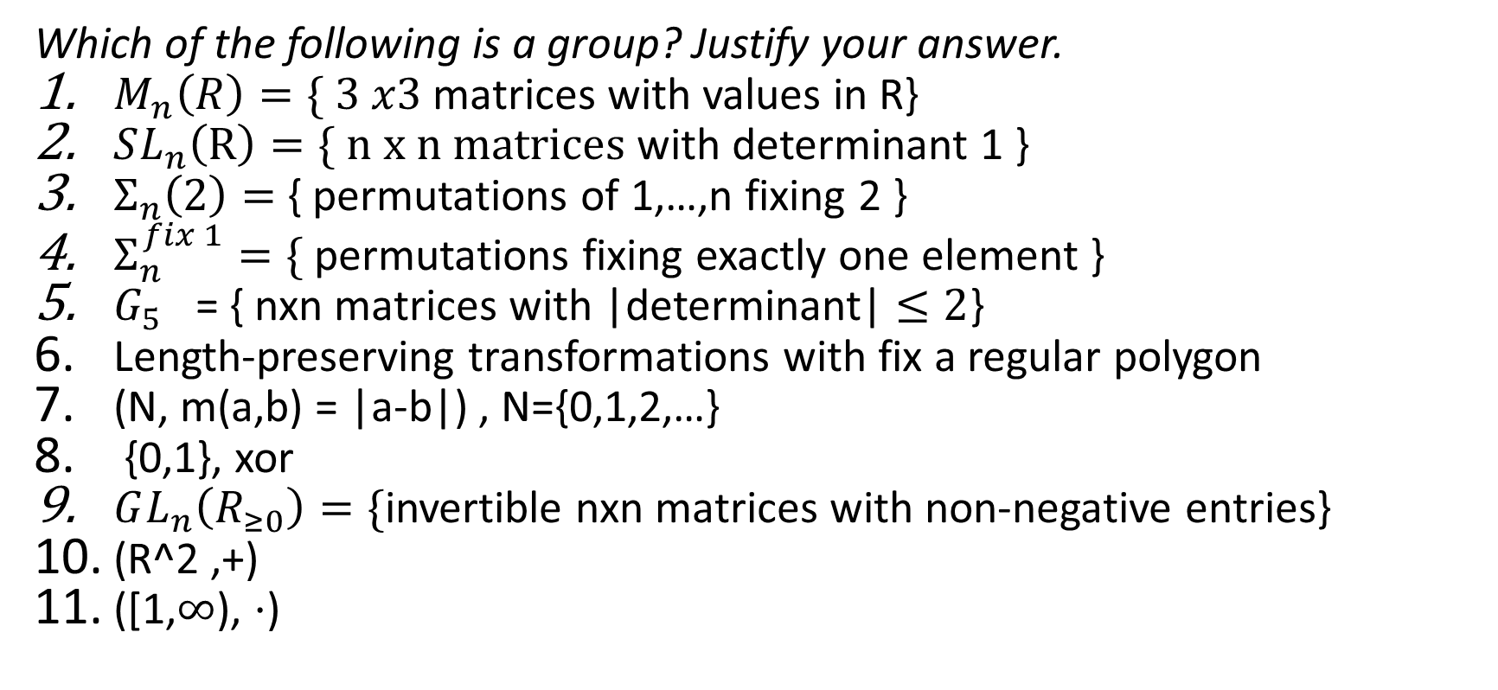
Exercise
Which of the following is a group? Justify your answer.
$M_{n}\left(R\right)=\{ 3 x3$matrices with values in R}
$SL_{n}\left(R\right)=\{ n x n matrices$ with determinant 1 }
$Σ_{n}\left(2\right)=$ { permutations of 1,…,n fixing 2 }
$Σ_{n}^{fix 1}=\{$ permutations fixing exactly one element }
$G_{5}$ = { nxn matrices with |determinant| $≤2$}
Length-preserving transformations with fix a regular polygon
(N, m(a,b) = |a-b|) , N={0,1,2,…}
{0,1}, xor
$GL_{n}\left(R_{≥0}\right)=\{$invertible nxn matrices with non-negative entries}
(R^2 ,+)
([1,$∞$), $⋅$)

